Slide 1
The Greek Economy Moving Forward September 20, 2018
Yannis Stournaras
Governor
Bank of Greece

Slide 2
Outline
Economic adjustment over the past 8 years
Short–term economic developments and prospects: The Greek economy is recovering-Improvements in financial indicators
Looking forward
The financial sector is improving
Final remarks: Moving forward

Slide 3
1. Economic adjustment 2010-2018

Slide 4
Progress over the past 8 years
The Greek crisis was different from the banking and flow of financial capital crisis of other crisis-hit euro area member-states: It stemmed from major macroeconomic imbalances, led by expansionary fiscal policies and governance failures, which accumulated over a long period of time; the result – a sovereign debt crisis in 2010, which contaminated the banking sector.
Over the past 8 years, Greece has implemented bold economic reforms and an adjustment programme that has fully eliminated fiscal and external deficits, improved competitiveness, restructured, consolidated and recapitalised the banking system.

Slide 5
Progress over the past 8 years
As a consequence, openness has improved substantially and the economy is rebalancing towards tradable, export-oriented sectors.
Structural reforms improve growth potential ➔ OECD estimates that implemented and planned reforms are expected to boost real GDP by 13% over a 10-year horizon. BoG has similar estimates.

Slide 6
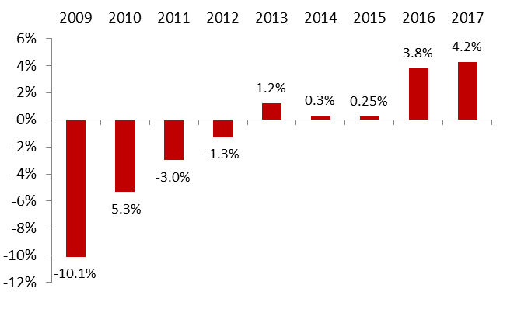
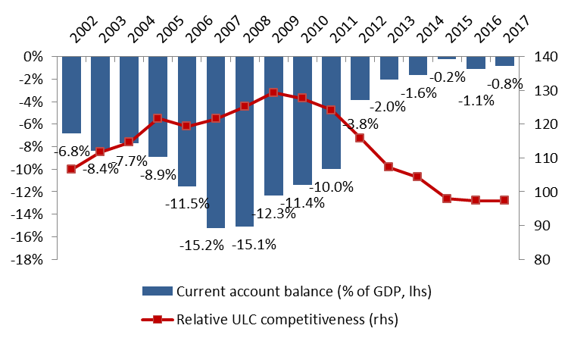
Fiscal and external deficits have been eliminated and cost competitiveness has been restored
General Government primary balance
(% of GDP, programme definition)
Current account balance (% of GDP) and Competitiveness (Index)
Source: Ministry of Finance
Source: Bank of Greece, ECB

Slide 7
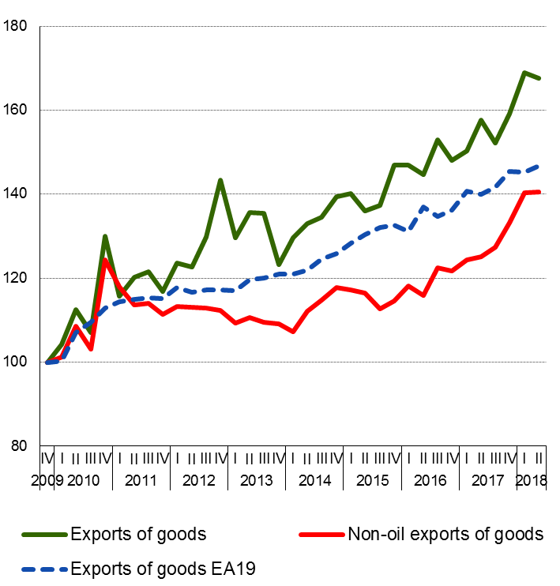
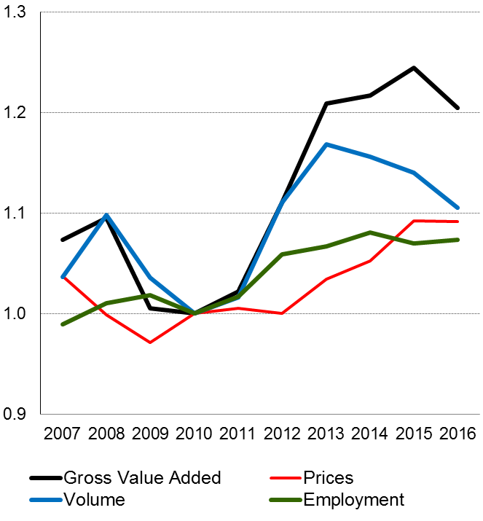
Exports increased and tradeable sector gained a higher share in the economy
Real exports of goods (2009Q4=100)
Relative size of tradeable-to-nontradeable sector
Note: tradeables = agriculture, industry, business and financial services, telecommunications and services related to tourism.
Non-tradeables = all else except public administration and non-market services.
Source: ELSTAT
Sources: Bank of Greece (BoP statistics) and Eurostat (for EA 19)
6

Slide 8
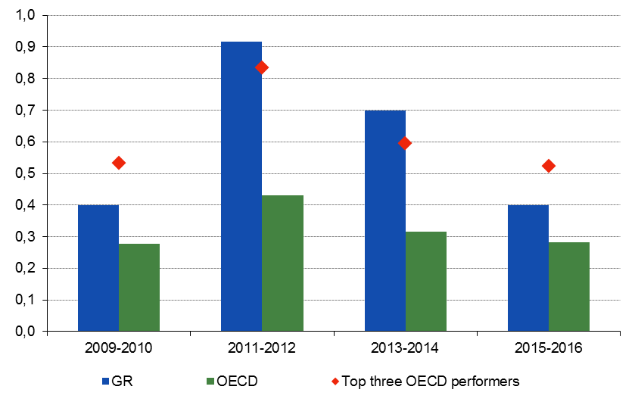
Reform implementation remains above OECD average
Responsiveness to OECD Going for Growth recommendations
Source: OECD Going for Growth 2010, 2013, and 2017.

Slide 9
2. Short term developments
and prospects:
-The economy is recovering
-Improvements in financial indicators

Slide 10
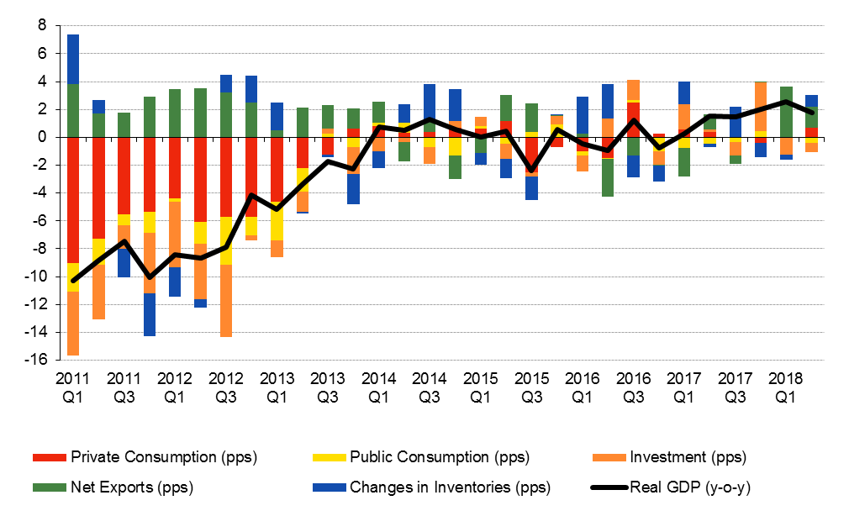
Following three years of stagnation, Greece is finally growing again.
Real GDP in 2017 increased by 1.4% due to the positive contribution of exports of goods and services (2.0 pp) and gross fixed capital formation (1.2 pp). Private consumption remained flat, while imports of goods and services and public consumption contributed negatively to growth (-2.4 pp and -0.2 pp, respectively).
In 2018H1, real GDP increased by 2.2%. Exports of goods and services contributed positively (1.6pp and 1.2pp, respectively) as did private consumption (0.35pp); gross fixed capital formation and imports had a negative contribution (-1pp and -0.2pp, respectively).
Source: ELSTAT

Slide 11
Several other hard and soft economic indicators point to growth acceleration in 2018
Positive developments are not only reflected in economic activity figures, but also in:
manufacturing production;
retail sales volume; and
employment.
Moreover, soft data indicators such as the
manufacturing PMI and
the economic sentiment indicator
have reached multiyear highs pointing to continuing economic expansion.

Slide 12
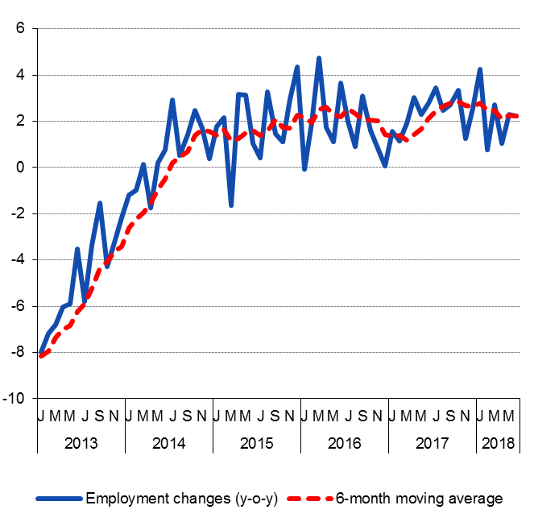
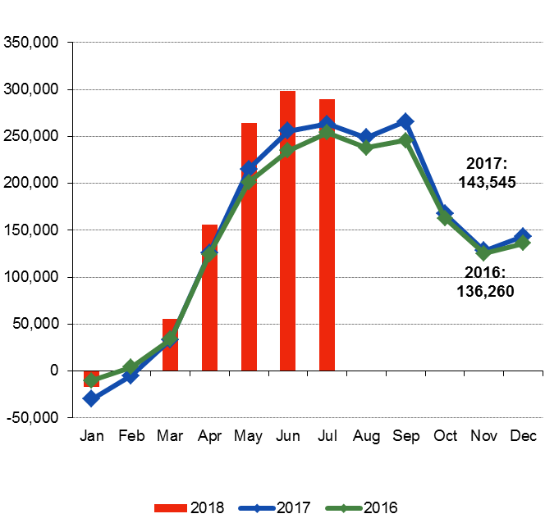
Labour market recovery continues for the third year despite almost stagnant GDP Net job creation is to a large extent due to increased labour market flexibility
Employment changes
(annual percentage change)
Net dependent employment flows (cumulative net flows; number of jobs)
Source: ELSTAT, Labour Force Survey
Source: OAED and ERGANI

Slide 13
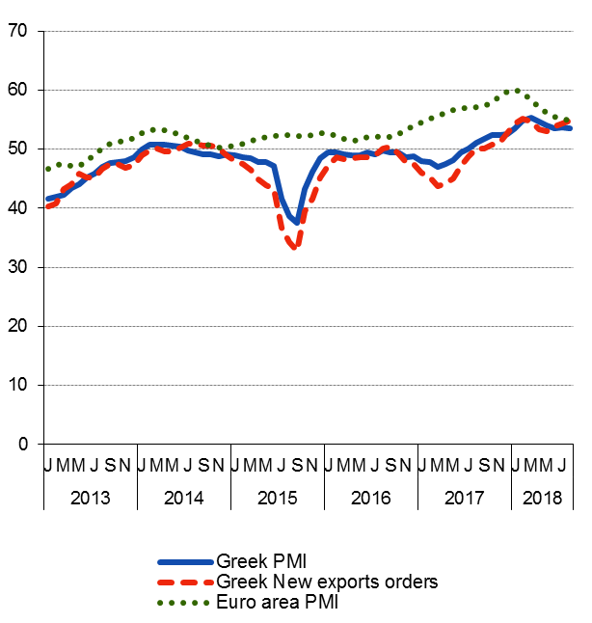
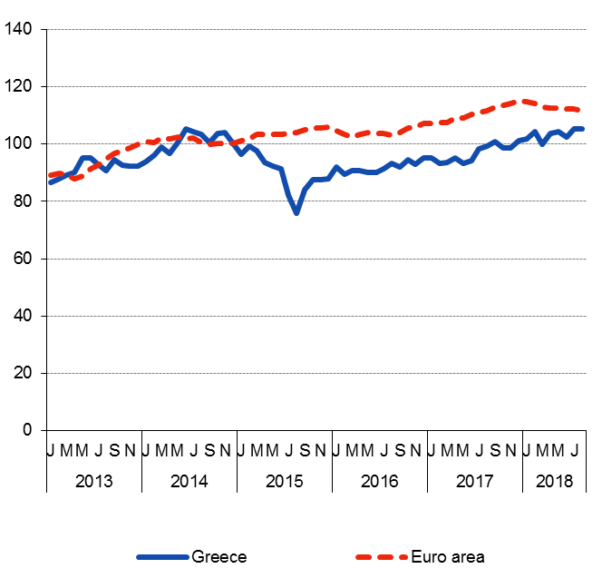
Soft data point to strong expansion in 2018
Greek and Euro Area PMI
(3m- moving average)
Greek and Euro Area Economic Sentiment Indicator
Source: Markit.
Source: European Commission.

Slide 14
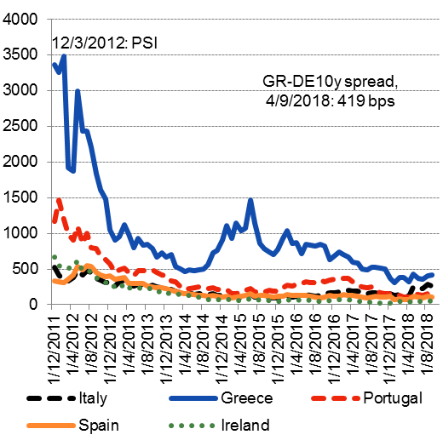
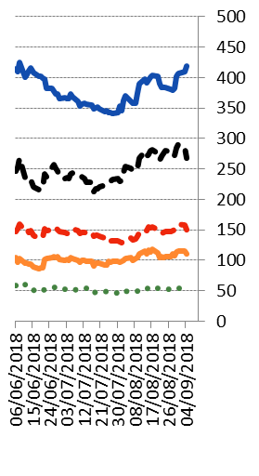
Improvements in financial indicators
Yields of Greek government bonds have declined to pre-crisis levels.
Greek government returned to international bond markets:
A five-year bond was issued in July 2017.
A swap of PSI bonds was conducted towards the end of 2017.
A seven-year bond was issued in February 2018.
Τhe Greek sovereign has been upgraded.
However, GGBs are still four notches below investment grade, while, after the end of the ESM Support Programme, ten-year bond spreads remain higher than 350 basis points. This is a serious problem which needs attention.
Spreads of 10-year government bond yields over comparable Bunds (basis points; left panel: monthly data, 2012 to date; right panel: daily data, last three months)
Source: Thomson Reuters

Slide 15
3. Looking forward
Bank of Greece expects economic activity to pick up in the medium term, with GDP expected to grow by 2.0% in 2018 and 2.3% in 2019.
Growth will be driven by:
robust export performance – both goods and services – benefiting from the global expansion and competitiveness gains;
solid private consumption growth, supported by rising employment; and
investment spending benefiting from the gradual improvement in both confidence and funding conditions.
Key assumptions: the reform and privatization programme will be implemented smoothly and according to the agreed time schedule, commitments undertaken will be implemented
External downside risks: a slowdown in global economic activity; an increase in investors’ risk aversion due to disturbances in international financial markets; the rise in protectionism worldwide; geopolitical risks.
Main challenge now: to access financial markets on sustainable terms

Slide 16
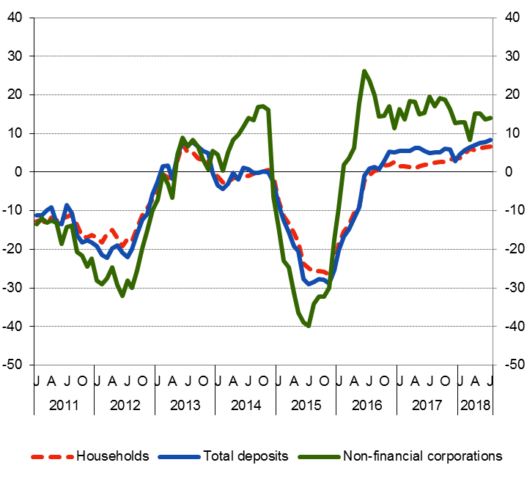
4. The financial sector is improving
Deposits of non-financial corporations and households (annual percentage change)
Bank deposits of the non-financial private sector have increased by about EUR15 bn since mid-2016;
Banks have regained access to repo markets;
Capital controls are being relaxed;
Banks’ dependence on central bank financing has declined significantly.
Source: Bank of Greece.

Slide 17
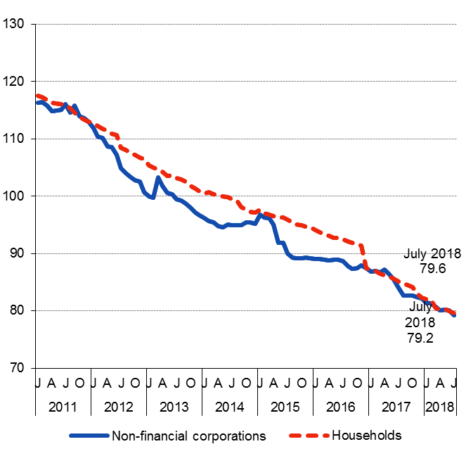
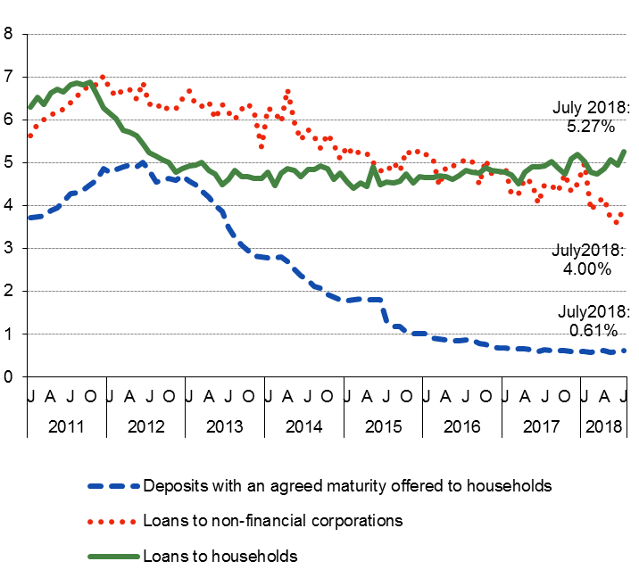
Bank credit to non-financial corporations has stabilized but financial conditions remain tight and bank lending rates are high compared to other euro area countries.
Bank credit to non-financial corporations and households
(Outstanding amounts in EUR billion)
Bank interest rates of new loans and deposits to euro area residents
(annual percentages, weighted averages)
Source: Bank of Greece.
Source: Bank of Greece.

Slide 18
The banking system is now on a more stable footing
The Greek banking system has been restructured, consolidated and recapitalized, following stringent stress tests along with in-depth asset quality reviews.
➔Greek banks are now among the best capitalized in Europe.
➔ Based on June 2018 data the CET1 ratio came to 15.7% (December 2017: 17.0%) and the CAR to 16.3%
(December 2017: 17,0%).

Slide 19
Results of the 2018 stress test for Greek banks
Bank | CET1 ratio, starting level (end-2017 IFRS9 restated figures) | Estimated 2020 CET1 ratio under baseline scenario | Estimated 2020 CET1 ratio under adverse scenario | Capital depletion under adverse scenario
Alpha Bank | 18.25% | 20.37% | 9.69% | -8.56 pp
Eurobank | 17.93% | 16.56% | 6.75% | -8.68 pp
NBG | 16.48% | 15.99% | 6.92% | -9.56 pp
Piraeus Bank | 14.85% | 14.52% | 5.90% | -8.95 pp
Note: All figures refer to phase-in ratios.
18

Slide 20
The four banks underwent a stress test following the same methodology and approach as the EU-wide EBA exercise, but with an accelerated timetable in order to complete the test before the end of the European Stability Mechanism’s Stability Support Programme for Greece in August.
The stress test is not a pass or fail exercise. Its results, together with other relevant supervisory information, are used to form an overall supervisory assessment of the banks’ situation.
The stress test scenarios include the following real GDP projections for Greece as outlined in the table below.
Assumptions for GDP growth in the baseline and adverse scenarios (in %)
 | Baseline scenario |  |  | Adverse scenario
Year | 2018 | 2019 | 2020 | 2018 | 2019 | 2020
GDP growth | 2.4% | 2.5% | 2.4% | -1.3% | -2.1% | 0.2%
19

Slide 21
5. Final remarks: Moving forward
Over the past 8 years, macroeconomic flow disequilibria have been eliminated, reforms have contributed to a substantial improvement of competitiveness, while the banking system has been restructured, consolidated and recapitalised. However, stock disequilibria remain as the main legacy of the crisis: high public debt and a high ratio of non-performing loans.
Today is a good starting point for the Greek economy to embark on a sustainable outward-oriented growth model – initial signs of increased openness already present.

Slide 22
Final remarks: Moving forward
The debt measures agreed at the 21 June 2018 Eurogroup, which further defer part of interest and amortisation payments by 10 years and increase weighted average maturity by 10 years, is an important step towards debt sustainability.
The economy is now growing with exports of goods and services contributing considerably.

Slide 23
Final remarks on the macroeconomic front
To ensure that the Greek sovereign banks and other companies can return to financial markets on sustainable terms and the Greek economy to move towards a sustainable export led growth model, the focus of economic policy should be on the following: creation of strong economic and financial fundamentals; avoidance of past mistakes; no backtracking on past commitments; reduction of public debt; reduction of the ratio of non-performing loans; further improvement in corporate governance of banks and other companies, private and public; further de-politicisation of public administration; promotion of excellence and evaluation in all aspects of public activity; implementation of further privatisations and structural reforms; implementation of policies to secure the long-term sustainability of the social security system and social welfare.

Slide 24
Final remarks on the macroeconomic front
Furthermore, implementation of appropriate policies with a view to
(a) attracting foreign direct investment needed to close the domestic “investment - savings gap”;
(b) increasing productivity, which is absolutely necessary to offset the impact of the projected population decline;
(c) consolidating economic sentiment mainly by strengthening independent institutions;
(d) fostering the “knowledge triangle” (education, research, technology), which is key to the long-term welfare of citizens and a shield against risks.

Slide 25
Final remarks on the macroeconomic front
As regards the banking system, tackling the problem of non-performing exposures (NPEs) which constrains the banking system’s ability to finance economic growth, is a priority.
Banks need to step up their efforts to attain their operational targets for reducing their NPEs, which will become more demanding after 2019.
They should facilitate the restructuring of viable businesses, the identification of strategic defaulters and the liquidation of non-viable businesses.
Due attention should be paid on the implementation of IFRS 9 and a stricter treatment of loan-loss provisions.
The results of the recent (2018) stress test are encouraging and allow more optimism on the ability of Greek banks to contribute to the growth of the Greek economy in a sustainable way .

