Slide 1
Training Material for SMEs

Slide 2
Energy Efficiency
It refers to the use of technology that requires less energy to achieve the same performance or perform the same function.
Energy efficiency focuses on technology, equipment or machinery being used in buildings
Energy conservation focuses on people’s behavior to use less energy (e.g. maximum use of natural light instead of artificial lighting).

Slide 3
Why is Energy Efficiency important?
Global energy consumption is increasing
Energy costs are increasing
High dependence on energy imports
Climate change

Slide 4
EU Energy Policy
Treaty of Lisbon
Place energy at the heart of European activity
Article 194 of the Treaty on the functioning of the European Union
European Union policy on energy shall aim to:
Ensure the functioning of the energy market;
Ensure security of energy supply in the Union;
Promote energy efficiency and energy saving and the development of new and renewable forms of energy; and
Promote the interconnection of energy networks.

Slide 5
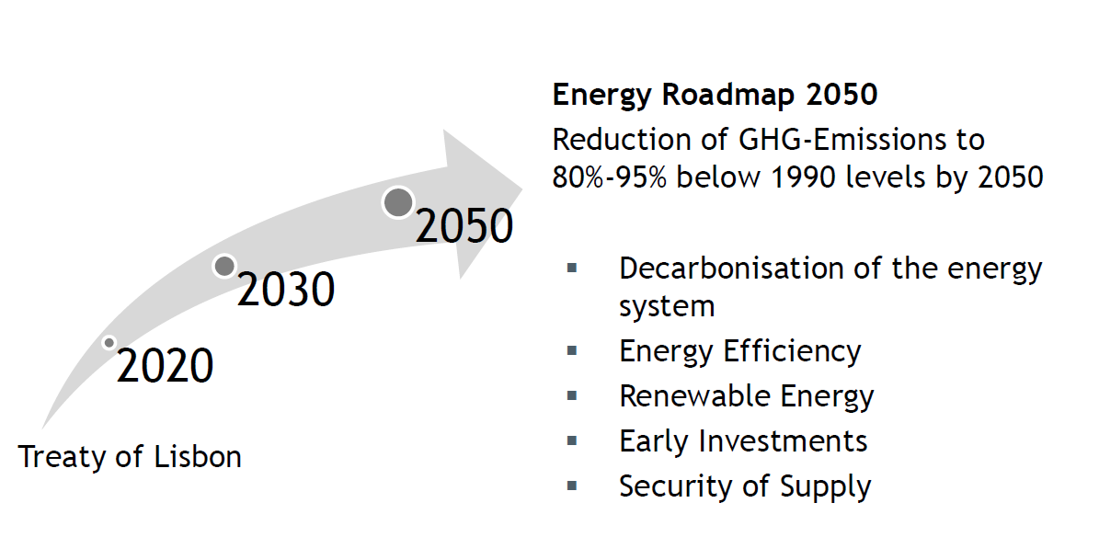
EU Energy Policy

Slide 6
Energy 2020 – Energy Efficiency
Energy Efficiency Directive (2012/27/EU)
Implementation for Member States foreseen by June 2014
Common framework of measures for the promotion of EE
Use of energy more efficiently at all stages of the energy chain
Measures included
  Set indicative national energy efficiency target
  Easy and free-of-charge access to data on real-time and historical energy consumption
  Renovating of buildings
  Efficiency in energy generation
Ecodesign Regulations (2009/125/EC)
Art. 8 […] Member States may set up support schemes for SMEs, including if they have concluded voluntary agreements, to cover costs of an energy audit and of the implementation of highly cost-effective recommendations from the energy audits, if the proposed measures are implemented […]

Slide 7
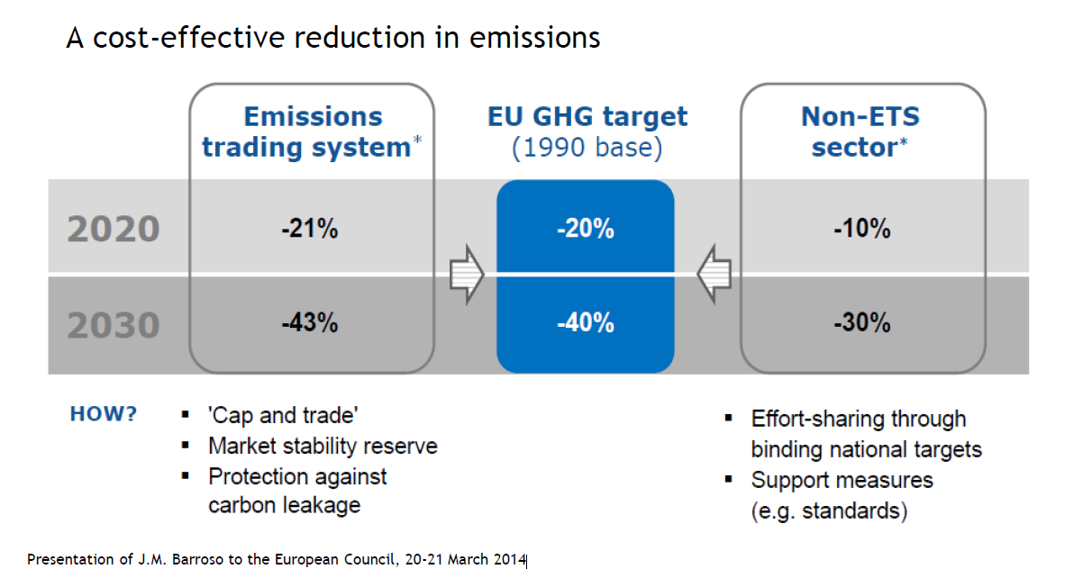
2030 Framework

Slide 8
Energy Management
“Energy Management is the systematic use of management and technology to improve an organisation’s energy performance. It need to be integrated, proactive, and incorporate energy procurement, energy efficiency and renewable energy to be fully effective”.
Carbon Trust Energy Management Guide

Slide 9
The Need for Energy Management
Why does your company require energy management?
Energy is a manageable cost
Regulatory control and limits
Corporate Responsibility
Client requirements
Peer pressure
To win business

Slide 10
Benefits for your company
Cost savings
Increase competitiveness (reduced costs for clients)
More information on your company
  strategic planning and opportunity for improvement
Risk reduction
Motivation of employees
Image

Slide 11
Energy Management System
Energy Management Standard ISO 50001
ISO 50001: Structure
Benefits of Energy Management Systems
10 important building blocks of an EnMS
Examples

Slide 12
Energy Management Standard ISO 50001
Purpose: enable organisations to establish the systems and processes necessary to improve energy performance (includes energy efficiency, use and consumption)
For all types and sizes of organisations
DOES NOT prescribe absolute requirements/ targets regarding energy performance
(except adherence to legal obligations and other requirements that the company has subscribed to)

Slide 13
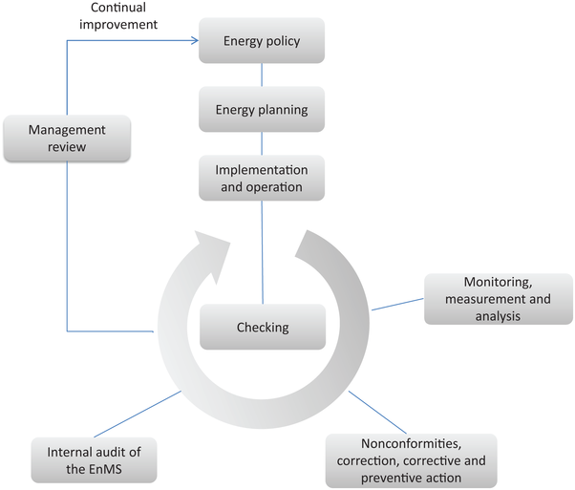

ISO 50001: Structure based on Plan-Do-Check-Act Cycle
PLAN: status quo analysis, define indicators, goals and action plans
ACT: measures to improve the EnMS and the energy performance
DO: Implementation of action plans
CHECK: monitor processes, measure results, documentation

Slide 14

Benefits of Energy Management Systems
  Certified EnMS:
  More credibility - good for image
  Legal compliance concerning laws & regulations with respect to energy
  Suggestions for improvement of system by external auditor
  EnMS:
  Better, more transparent data
  Systematic identification of energy efficiency potentials
  Consideration of effects of interaction of different measures
  Staff involvement
  Documentation of results, more long-term perspective
  Ad hoc Energy Efficiency Measures:
  Cost savings & positive environmental effects (& additional benefits)

Slide 15
10 important building blocks of an EnMS
  Overview of energy situation of organisation (technical, organisational, efficiency potentials & opportunities)
  Energy policy = Commitment of Top Management to improvement of energy performance
  Designate Energy Manager
  Set up energy information system / energy accounting
  Set strategic and operative energy targets.
  Define energy management programme = concrete measures, responsibilities and resources for implementation

Slide 16
10 important building blocks of an EnMS
  Check energy relevant processes, plan them as efficiently as possible, and document criteria
  Raise awareness among staff for energy topics (internal communication), inform about efficient behavior (trainings, operating instructions), involve in improvement process (suggestion scheme)
  Regularly check and record fulfilment of goals and correct operation of energy relevant processes
  Correct deviations, update goals and energy management programmes, and develop them further.

Slide 17
Example:
Energy objectives, targets & programmes

Slide 18
Example:
Operational controls & monitoring

Slide 19
Energy Efficiency in Practice
Energy consumption and costs are related to technical and human factors
When analysing your energy use, you need to consider the following:
  Lighting system
  Heating system
  Cooling system
  Building
  Compressed Air system
  Office equipment

Slide 20
Lighting
Maximise the use of daylight
  Reduce luminance to minimum required levels
Choose light colored interior wall finishes in your building.
  The more dark colours you have, the more artificial light is needed
Selective switching: light only where necessary
  Switch off lights when not needed/ in unoccupied areas
  Split the lighting into multiple groups

Slide 21
Lighting
Investments:
Install programmable timers and/or occupancy sensors (10 to 20% saving) in toilets, corridors, cellars, garages…
Install daylight harvesting controls in every area receiving natural light.
Together they can reduce energy usage and costs by up to 45%
Replace electromagnetic chokes of fluorescent tube lights with energy efficient electronic ballasts
  Limit the amount of current in an electronic circuit. They consume two to three times less than the magnetic ballast
  Relighting: switch to energy efficient lighting

Slide 22
Energy efficient lighting
Do you know that inefficient light bulbs have been banned in the EU?
Since 01.09.2010 clear 75W (over 750 lumen)
Since 01.09.2011 clear 60W (over 450 lm)
Since 01.09.2012 clear 20W-40W (over 60 lm)
From 01.09.2013 tightened standards on CFLs and LEDs
  No lamp type will be removed from the market,
  only lamps with poor performance will be banned.
  2014 review of the regulations by the EU Commission.
  From 01.09.2016 tightened standards for clear halogen lamps
  Only energy class B halogen lamps (C for some special cap lamps) will be permitted. All other halogen lamps will be banned!
Ensuring electrical products safety:
ENEC is the high quality European Mark for electrical products that demonstrates compliance with European standards (EN).

Slide 23
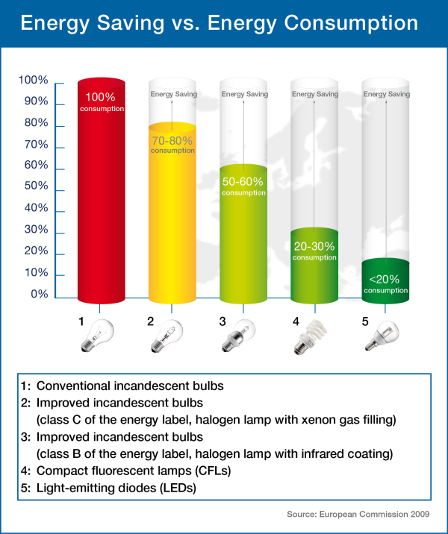
Lighting
Choose efficient light bulbs
(~life 6000 – 15000 hours compared to 1000 hours for conventional incandescent bulbs) :
Improved incandescent bulbs
Compact Fluorescent Lamps (CFL)
Light Emitting Diodes (LEDs)
Which bulb do I need?
Light bulb selector
The new bulbs: a guide
Exercise
Notes:
To be added the Link to the excel sheet presented by LEEN System GMbh during the 2nd multilateral training Berlin about the profitability of an investment:
Retrofitting of bulbs
500 CFLs are replaced by 500 LEDs. Is that profitable?
General Data
Interest rate: 10%
Operational time: 3,500 h/a
Electricity price: 0.14 €/kWh
CFL
Costs per bulb: 8 €
Power: 60 Watt per CFL
Time of use: 8 a
LED
Costs per bulb: 35 €
Power: 30 Watt per LED
Time of use: 16 a

Slide 24
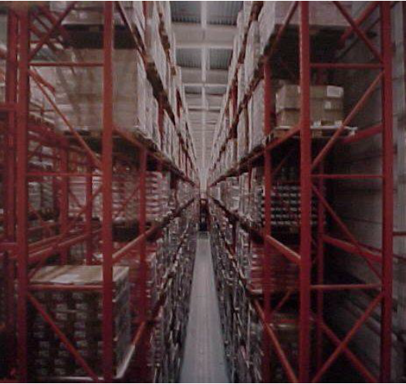
Effect of relighting: New lighting & fixtures
Colour rendering (CRI 100)
Lumen output ( lumen/watt)
Colour temperature (Kelvin)
Before relighting: 2 x 58W - 75lux
After relighting: 1 x 60W – 180lux

Slide 25

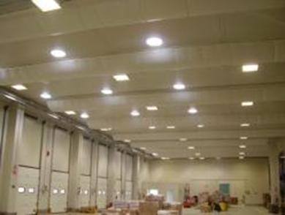
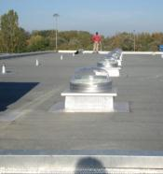
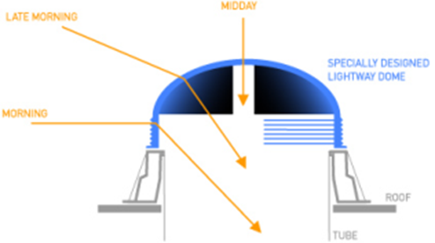
Lighting - Smart light domes
Bring or enhance the natural light in areas that do not have openings to the outside, or in addition to an existing opening.
Dome which catches the light, simple or with a special device to reflect light
Diffusor of light

Slide 26
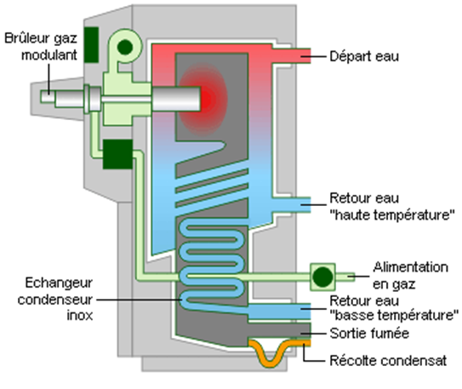
Heating
No cost measure: adjust rooms and boilers temperature
Choose thermal insulation of boilers, hot water tanks and water pipes
Clean the boiler: 1 mm of soot = 50 ° c fume temperature = yield loss of 4 - 8%
Switch to high efficiency boilers:
  Condensing boiler: designed to use the latent heat released by the condensation of water vapor produced during the combustion process
  efficiency of around 109%
  Up to 40% savings compared to conventional boilers
Place a weather-dependent control on the heating/cooling system
Choose radiant heating instead of heating air
Condensing boiler
Example of infrared radiant heater

Slide 27
Heating
Choose for the CV
Recover the heat of the ventilation and re-use it
Reduce the zones to be heated
Large consumers of electric and heat energy may consider cogeneration / CHP (Combined Heat and Power) in order to generate efficiently both electrical power and heating
  hotels, hospitals, care facilities, swimming pools, offices, schools,
  micro and mini–CHP for residential and small business (5 – 10kW)
Consider a solar collector (water heater) for pre-heating and heating domestic hot water

Slide 28
Cooling
Set the evaporating temperature as high as possible and the condenser temperature as low as possible
Maximise heat recovery of the heat produced by the cooling machines
Avoid heat sources (e.g. lighting) in cooled areas
Insulate cold pipes
Allow air to circulate well around the units
Establish a chiller efficiency-maintenance program, defrost regularly
  Cleaning the air conditioning reduce the related energy consumption of 10% in case of light clogging, of 30% in case the cleaning has never been done

Slide 29
Cooling - climatisation
Reduce sources of heat
Use solar glazing
Choose outdoor shades
Freecooling: use cold external air temperature during the night in warm periods)
Install, if possible, patio & fountain
Choose green roofs and facades
→ Choose electric cooling only as a last option

Slide 30
1°C temperature
decrease/increase
=
about 6% energy savings

Slide 31
Energy Management in Buildings
Energy management in buildings is about ensuring more comfortable, safe and healthy working circumstances with the same amount of energy or less energy.
Benefits of energy management in buildings:
  Reduces energy consumption → cost-savings
  Increases comfort and safety
  Reduces pollution
  Increases the energy security
  Reduces dependency on energy sources

Slide 32
Energy performance of Buildings
The potential for making energy savings in the building sector is widely recognized, especially through the refurbishment of existing buildings.
The Energy Performance of Buildings Directive, EPBD (Directive 2002/91/EC): main EU policy instrument to improve the energy performance of buildings. Among other measures, it introduced a framework for energy performance certification.
The recast of the EPBD in 2010 (Directive 2010/31/EU) strengthened the role of Energy Performance Certificate (EPC), for example by demanding publication of the energy performance indicator of the EPC at the time of advertising a building for sale or rental.

Slide 33
Energy saving measures and investments for buildings
Consumption profiles may vary but heating, cooling and lighting are the major energy users in buildings
Heating supply
Boiler (gas, fuel boiler)
Heat pump
Electrical heating
Geothermal heating system
Solar heating
Biomass boiler
Wood and pellet boiler
Heat losses
Roof ≈ 25%
Windows
≈ 10%
Walls ≈ 35%
Draughts
≈ 15%
Floor ≈ 15%

Slide 34
Energy saving measures and investments for buildings
Ventilation
  Mechanical or forced ventilation
  Natural ventilation (windows, trickle vents)
Air conditioning
Water supply (cold, hot)
  Cold water
    Water-saving solutions (e.g.: aerator for using less water)
  Hot water
    Creation of full circulation system
    Insulation
    Pipeline replacement
    Solar collector
Insulation
  Against cold and hot weather
  Insulation, replacement of windows and upgrading of other heating & ventilation systems result together up to 40% of energy saving.

Slide 35
Intelligent building
c. Green roof
f. Cooling at night
a. Good insulation
g. Controlled ventilation
b. sufficient windows
e. Good sun protection
d. Building engineering

Slide 36
Future?
Buildings may become an energy (thermal &/or electric) production unit for local needs.
They can even contribute to global electricity production.
New opportunities for European businesses, affordable energy bills for consumers.
Increased energy security through a significant reduction of natural gas imports and a positive impact on the environment.
EU energy efficiency target for 2030 (Energy Efficiency Communication, released on 23 July 2014):
  the proposed target of 30% builds on the achievements already reached: new buildings use half the energy they did in the 1980s and industry is about 19% less energy intensive than in 2001.

Slide 37
Compressed Air
Compressed air represents 10 to 20% of the electricity invoice.
Do you know how much electricity you consume for compressed air?
Is the use of compressed air really necessary?
90% of the energy consumption = heat!
Consider replacing with devices powered by batteries
Do you take care on your leakages and do you know how much they cost?
Detecting leaks = saving money
  Carry out periodic leak tests to estimate the quantity of leakage.
  At a working pressure of 7 bar a compressed air leak
    of 1mm costs 450€/year
    of 3mm costs 4.400€/year
    of 5mm costs 12.600€/year

Slide 38
Compressed Air
Set the system on minimum working pressure
  Reduce the operating pressure to what is really necessary:
  a reduction of the operating pressure of 0.5 bar means 3.5% less energy consumption
Look after the cold air supply (remove the compressor from the boiler room! A right ventilation of the equipment room = a temperature drop of 10 C and 3,5% of energy savings)
Limit the distance of the compressed air pipes. Place the compressor as close to the point of use
Recover the heat of the compressor to generate hot air or water for process application
Choose frequency controlled compressors

Slide 39
Energy Efficiency in the office
Office equipment is the fastest growing electrical load in the business sector. With the widespread use of desktop computers, printers and other devices, an office can have hundreds of units and the energy costs can add up.
Office equipment and other miscellaneous uses accounted for over 40% of electricity consumption in large office buildings with most of that by office equipment.
By purchasing the most efficient products, the electric bill will be reduced, adding to the bottom line.

Slide 40

Energy Efficiency in the office
COMPUTERS
largest energy consumers among office
ENERGY STAR computers and monitors automatically power down when not in use and are available from almost every manufacturer. Both computers and monitors power down to about 15% of their maximum power usage
FAX MACHINE
Because fax machines need to be available 24 hours a day, they have a huge potential for power saving technology
They also power down to 15 to 45 Watts or less when not in use, and can save over 50% on annual energy costs
Energy Calculator for PC equipment

Slide 41
Energy Efficiency in the office
COPIERS
The most energy intensive pieces of office equipment!
Energy consumption can be quite high, even when not in use.
ENERGY STAR copiers are equipped with power saver features that allow them to go to low-power mode after 15 minutes of inactivity and to an off-mode of five to 20 Watts after two hours of inactivity.
These features can reduce annual electricity costs by up to 60 %
Copiers with double-sided or duplex copying also help to save energy and reduce paper costs
PRINTERS
ENERGY STAR printers power down to 15 to 45 Watt and can save over 60% on annual energy costs. Printers with double-sided printing capability are more energy efficient and also help reduce paper costs.
Energy Calculator for Imaging Equipment

Slide 42
Other tips (I)
Turn the equipment off at the power source when not in use overnight or on weekends. Plug-in timers automatically turn equipment off at the power sources at certain times of day.
  They are especially useful for copiers and printers.
If the computer must be left on at night and weekends, save energy costs by turning off the monitor.
  Monitors typically use more energy than the computer itself.
Power-saver features need to be set up by the user on many products.
  Check the setup when you install new equipment and periodically to ensure that the power-saver functions are still working.

Slide 43
Other tips (II)
Screen savers do not save energy. Their purpose is to extend the useful life of the screen and avoid images being “burned” into the screen.
  Make sure the screen saver is compatible with the power management features of the computer and that the settings allow the unit to go into the power saver mode
Laser printers consume more energy than inkjet printers. Color printers use more energy than black and white.
Laptops draw about one-tenth the power of a conventional desktop computer.
  You can connect a laptop computer to a conventional monitor and still save almost half the energy of a standard computer.

Slide 44
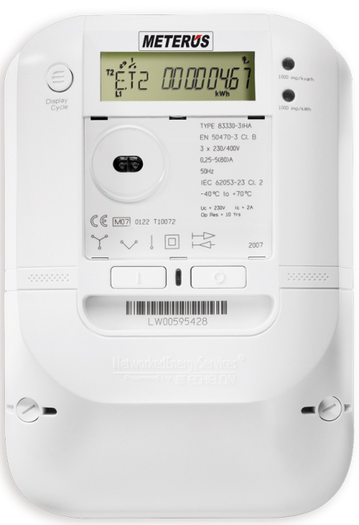
Smart Meters
What does it offer?
Accurate bills
Software, "Online" reading, local and remote
GSM / GPRS communicator
Meter single-phase and three-phase

Slide 45
Smart Meters - System
Measurement, records, monitoring, management
Automated computerized measuring system
Wireless communication with the center
Counter <-> GPRS communicator <-> PC application
The meter measures the active and reactive energy, power, current, voltage, load curves 1MB of data ...
On your computer, all the data for analysis
Maintenance costs, negligible (X per month)

Slide 46

An example of smart meter:
Linky in France
Decision by French government
to equip all energy consumers
(businesses and households) with
a smart meter called “Linky” by 2021
(www.erdf.fr/Linky)
Linky allows to measure at any
moment one’s real energy
consumption
Linky is being used in several smart-grid projects such as IssyGrid (www.issygrid.com)

Slide 47
Conclusion
The system enables:
Measuring, recording, understanding
Monitoring, Management
cost Control
Reducing costs €
Reducing pollution

Slide 48
Renewables
ENERGY EFFICIENCY + RENEWABLES =
SUSTAINABILITY
The EU target:
→ 20% of its energy from renewable sources by 2020.

Slide 49
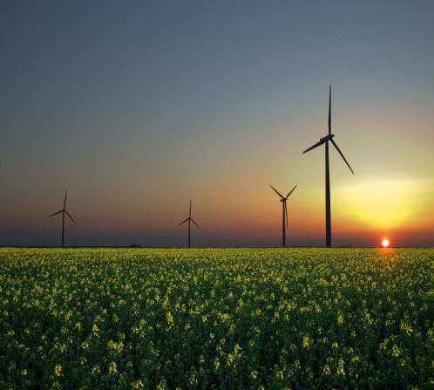
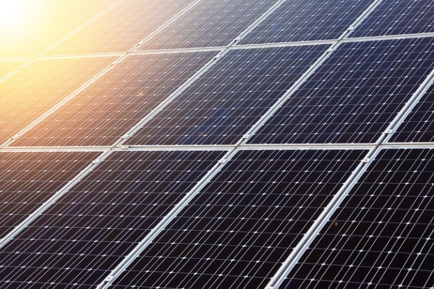
Renewables
Some Aspects of Renewable Energy:
It exists perpetually and in abundant in the environment
Ready to be harnessed, inexhaustible
It is a clean alternative to fossil fuels
“energy that is derived from natural process that are replenished constantly” – defined by the RENEWABLE ENERGY WORKING PARTY of the INTERNATIONAL ENERGY AGENCY

Slide 50
Renewables
Major Renewable Energy Sources:
Hydro Energy
Wind Energy
Solar Energy
Biomass Energy
Tidal Energy
Geotermal Energy
Wave Energy
Bio-fuel

Slide 51
Renewables
BENEFITS FOR YOUR BUSINESS:
Improved capacity for compliance with environmental demands
Better marketing opportunities due to improved renewable energy
Reduced operating costs
Increased energy security
Improved reliability of equipment and manufacturing process
Better positioning in production chains
Reduction of CO2 emissions

Slide 52
Energy Pyramid
Offsetting
Renewables, CHP
Building fabric e.g insulation
Building controls
Human scale interventions e.g. switch-off campaigns
start

Slide 53
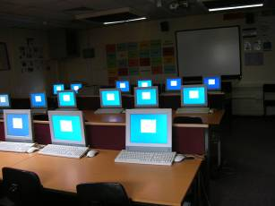
Low – hanging fruits
IT Consumption Switch-off rates for monitors around 30%

Slide 54
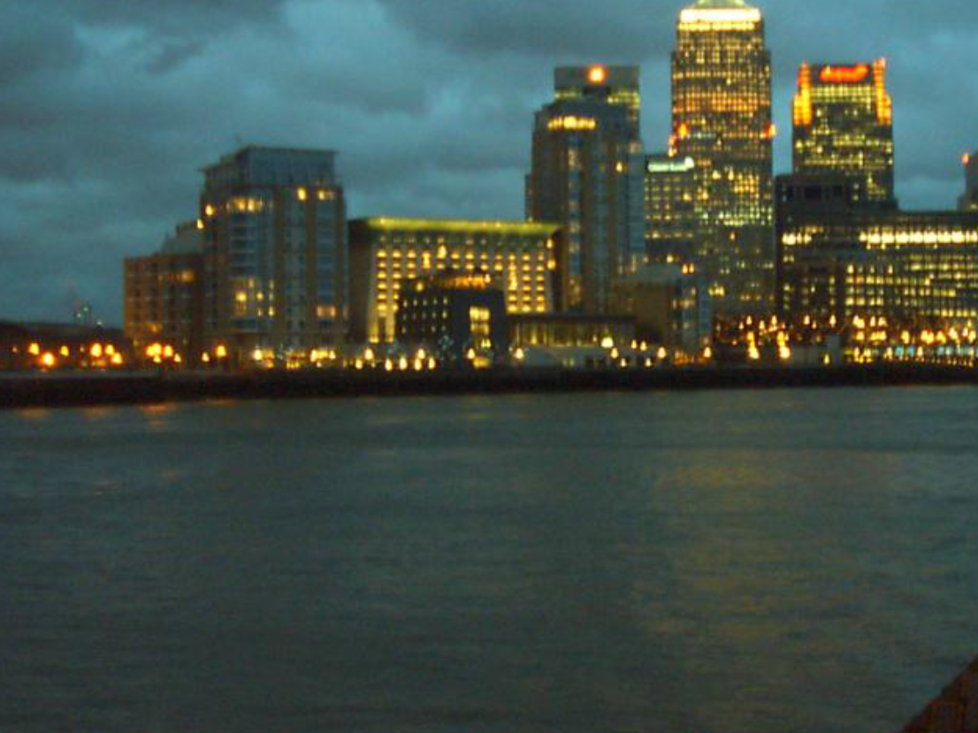
Low – hanging fruits
Saturday Evening around 6PM, Canary Wharf

Slide 55
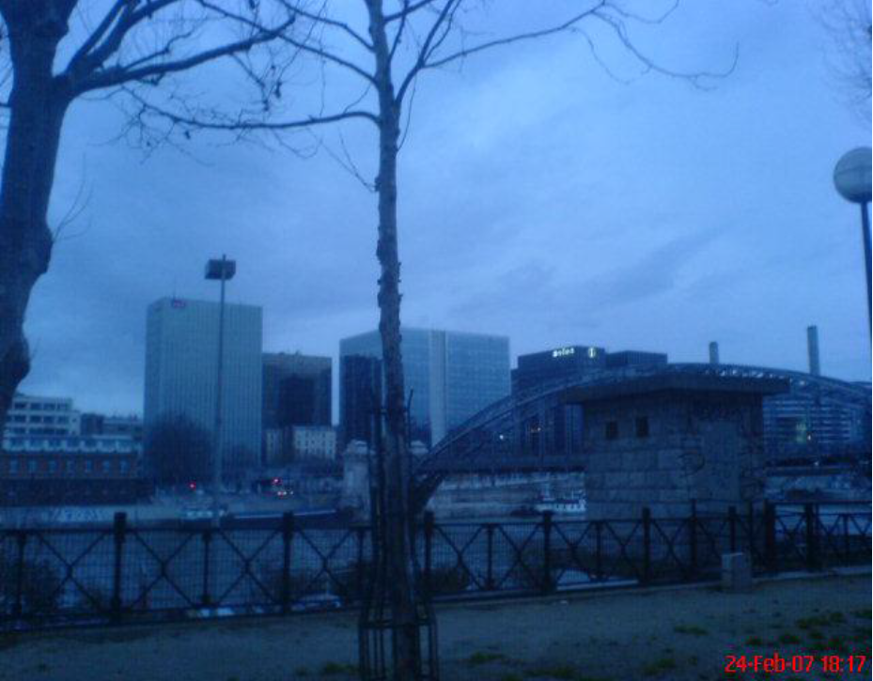
Low – hanging fruits
Saturday Evening around 6PM, Paris

Slide 56
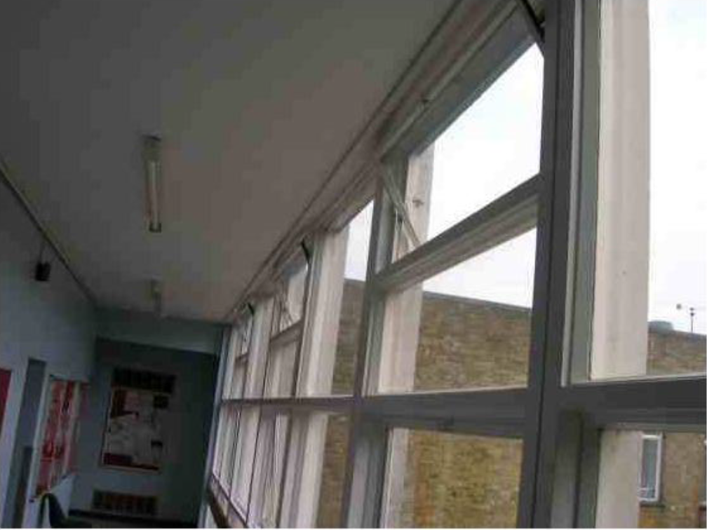
Low – hanging fruits

Slide 57
…and now? Energy management plan
Appoint an Energy manager
Define your goals
Collect your data → analysis of status quo
Evaluation (benchmarking and best practice examples)
Identify possible obstacles and responsibilities
Develop a concept (identify energy efficiency measures)
Implement measures
Control is knowing where to act

Slide 58
Energy Management
Analyse your energy consumption
  an audit of your energy consumption indicates potential savings and possible measures to be adopted
  Identify behavioral and operational changes
Organize awareness campaigns
  Explain your programme to the staff
  Find the right motivations (improved comfort, increased productivity, possibility to implement EE at home, etc.)
  Find the right communication channels,
  Involve the staff in agreeing the solution

Slide 59
Energy Management
Reduce standby consumption
  Eliminate standby consumption during nights and weekends
  Make an inventory of the equipment that should guarantee the operational safety of the company during the unproductive periods and switch all other equipment off (lights, ICT, air-conditioning, …)
Peak shaving: reducing your electrical power consumption during periods of maximum demand = 10% energy savings
  Shift demand from "peak times" (e.g. Morning, noon) to times with lower demand (e.g. night)
  “Start up ater on devices/installations that do not need to run immediately

Slide 60
Energy Management
Identify improvements to equipment and buildings
Choose energy-efficient appliances
Choose green power
Aim at a good power factor
  It is a measure of system electrical efficiency
  Supplied electrical power = productive power (kW) + reactive power (kVAr)
  Power factor is the ratio of productive power to the total supplied electrical power (kVA)
  Utility companies charge a penalty for poor power factor

Slide 61














The sole responsibility for the content of this presentation lies with the authors. It does not necessarily reflect the opinion of the European Union. Neither the EASME nor the European Commission are responsible for any use that may be made of the information contained therein.

